Slide 1
Pre-trained Encoders in Self-Supervised Learning Improve Secure and Privacy-preserving Supervised Learning
Hongbin Liu, Wenjie Qu, Jinyuan JiaNeil, Zhenqiang Gong

Slide 2
Use pre-trained encoders from self-supervised learning
Problem: Supervised learning has security and privacy vulnerabilities, such as adversarial attacks and inference attacks.
Solution: Use pre-trained encoders from self-supervised learning to improve accuracy, security, and privacy in supervised tasks.
Findings:
Improved testing accuracy and certified security guarantees.
Better efficiency and accuracy for privacy-preserving tasks like machine unlearning and differential privacy.

Slide 3
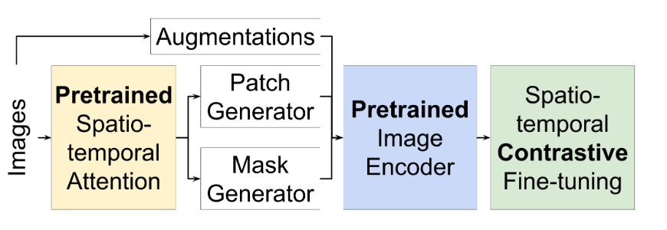
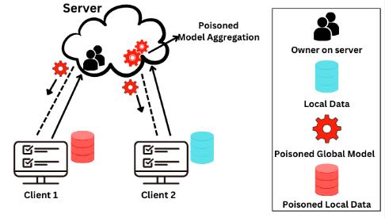
Introduction
Supervised Learning
Used in critical applications like cybersecurity and healthcare.
Relies on labeled data but faces security issues like data poisoning and backdoor attacks.
Privacy challenges include compliance with GDPR and protection against inference attacks.
Self-Supervised Learning
Pre-training encoders on unlabeled data extracts high-quality features.
Enables building accurate classifiers with minimal labeled data.
Data Poisoning
Pre-training encoders

Slide 4
Limitations in Supervised Learning
Security Limitations in Supervised Learning
Reduced accuracy when using secure algorithms (e.g., Bagging, KNN).
Weak certified security guarantees.
Privacy Limitations in Supervised Learning
Differentially private methods reduce testing accuracy.
Exact machine unlearning is inefficient.

Slide 5
Self-Supervised Learning
Pre-trained encoders learn general features from large, unlabeled datasets.
Example: OpenAI’s CLIP trained on 400M image-text pairs.
Encoders extract better features, improving downstream supervised learning tasks.
Public data removes privacy concerns.
Two Approaches for Training:
Linear Probing (LP): Train only the classifier layer.
Fine-Tuning (FT): Update the encoder and classifier layers.

Slide 6


Measurement Setup
Datasets: STL10, CIFAR10, Tiny-ImageNet.
Case I: Simple linear classifier.
Case II: Deep neural network (DNN) trained from scratch.
Case III: Pre-trained encoder with LP or FT.
Metrics:
Testing accuracy.
Certified security guarantees.
Efficiency and accuracy for privacy-preserving tasks.

Slide 7
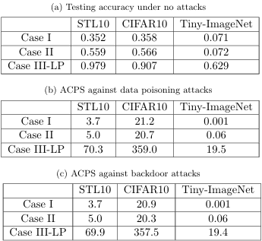
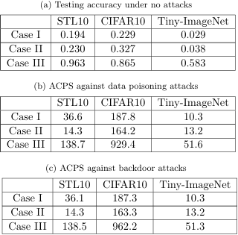
Security Improvement
Improved Accuracy:
Case III with pre-trained encoders achieves higher accuracy across datasets
(e.g., STL10: 97.9%).
Against Data Poisoning/Backdoor Attacks:
Pre-trained encoders improve certified poisoning size and backdoor attack resistance
(e.g., Bagging’s ACPS increases significantly in Case III).
Randomized Smoothing:
Larger certified radii without accuracy loss.
Comparing cases between bagging and knn

Slide 8
Privacy Preservation
Differentially Private Classifiers:
Case III-LP maintains high accuracy under strong privacy constraints
(e.g., STL10 accuracy: 95.6%).
Case III-FT less effective under strong privacy constraints due to noise sensitivity.
Exact Machine Unlearning:
Retraining from scratch is more efficient and accurate in Case III due to pre-trained features.

Slide 9
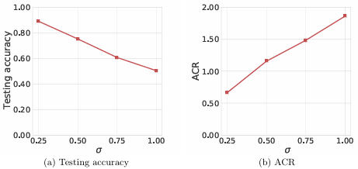
Efficiency Analysis
Computation and Storage Costs:
Linear probing (LP) is more efficient than fine-tuning (FT).
FT achieves slightly better performance but at a much higher computational cost.
Practical Recommendations:
Use LP for efficient privacy-preserving and secure learning.
Impact of on the testing accuracy and ACR of randomized smoothing

Slide 10
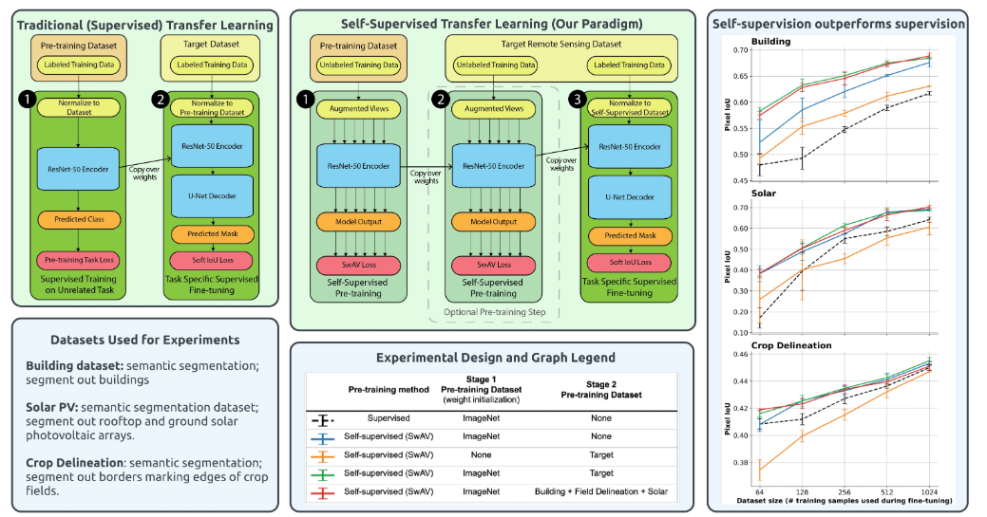
Conclusions
Key Takeaways
Pre-trained encoders significantly enhance both security and privacy in supervised learning.
They mitigate accuracy and efficiency trade-offs in traditional methods.
Case III with linear probing offers the best trade-off between accuracy, security, and efficiency.
Future Work
Investigating encoder robustness and privacy-preserving pre-training.

Slide 11
References
[2] Public pre-trained image encoder by Google. https://storage.cloud.google.com/simclr gcs/checkpoints/ResNet50 1x.zip, 2021.
[4] Martin Abadi, Andy Chu, Ian Goodfellow, H Brendan McMahan, Ilya Mironov, Kunal Talwar, and Li Zhang. Deep learning with differential privacy. In Proceedings of the 2016 ACMSIGSACconference on computer and communications security, pages 308318, 2016.
[5] Naomi S Altman. An introduction to kernel and nearest-neighbor nonparametric regression. The American Statistician, 46(3):175185, 1992.
[6] Giuseppe Ateniese, Luigi V Mancini, Angelo Spognardi, Antonio Villani, Domenico Vitali, and Giovanni Felici. Hacking smart machines with smarter ones: How to extract meaningful data from machine learning classifiers. International Journal of Security and Networks, 10(3):137150, 2015

